Slide 1

VEO FLEX
SALES PRESENTATION
Presented by Product Marketing
January, 2019

Slide 2
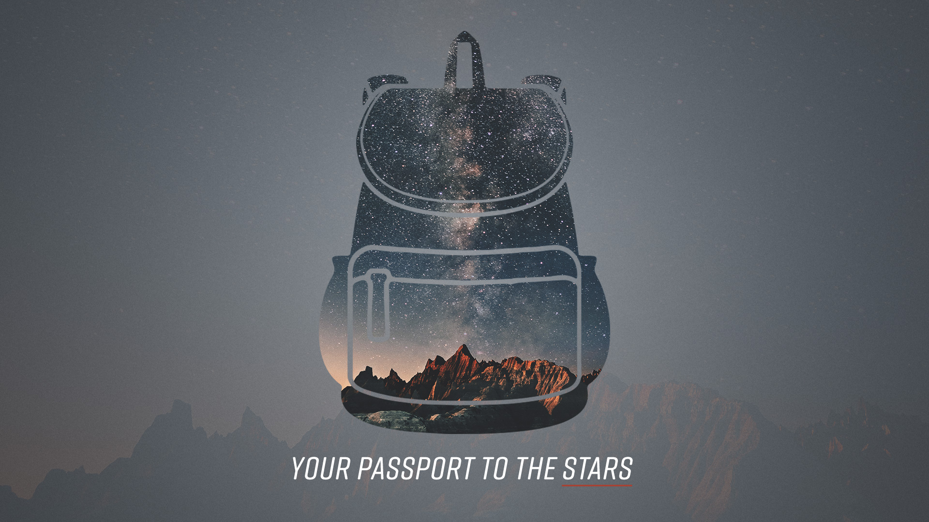



VEO 2S BAGS
VEO FLEX INTRODUCTION
VEO FLEX SALES PRESNTATION
JJANUARY 2019
FLEX for MORE, or LESS…
Having your Camera with you no matter where you are, is key to shooting that memorable experience, and this is why VANGUARD continues to focus on designing new stylish bags that can accompany you anywhere and everywhere.
VEO FLEX is joining VEO GO to offer dedicated Mirrorless/CSC/Hybrid Cameras bag solutions, with a new exciting rolltop style proposition. VEO FLEX offers great “min to max” flexibility for ever-changing gear and personal needs. Quality materials and construction meet, offering superb durability and protection alongside ultimate compactness and minimal weight. The backpacks can easily transform into regular daypacks, and the large shoulder bag has a unique tripod compartment inside. All models offer great versatility to accommodate a variety of alternative gear, such as: small drone, gimbal or video accessories.
Match any of the VEO FLEX bags with VEO 2 GO tripods for the ultimate compact and lightweight support you have always wished for!

Slide 3
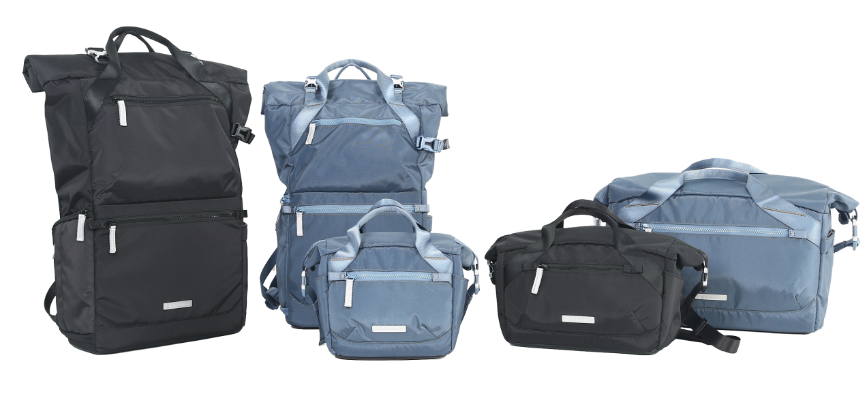
VEO FLEX RANGE
VEO FLEX SALES PRESNTATION
VEO FLEX 18M I BK and BL I Shoulder Bag
VEO FLEX 25M I BK and BL I Shoulder Bag
VEO FLEX 35M I BK and BL I Shoulder Bag
VEO FLEX 43M I BK and BL I Backpack
VEO FLEX 47M I BK and BL I Backpack
M for Mirorrless & Much More…
Notes:
Note: Click on the “Picture Place Holder”, then send the picture back.

Slide 4
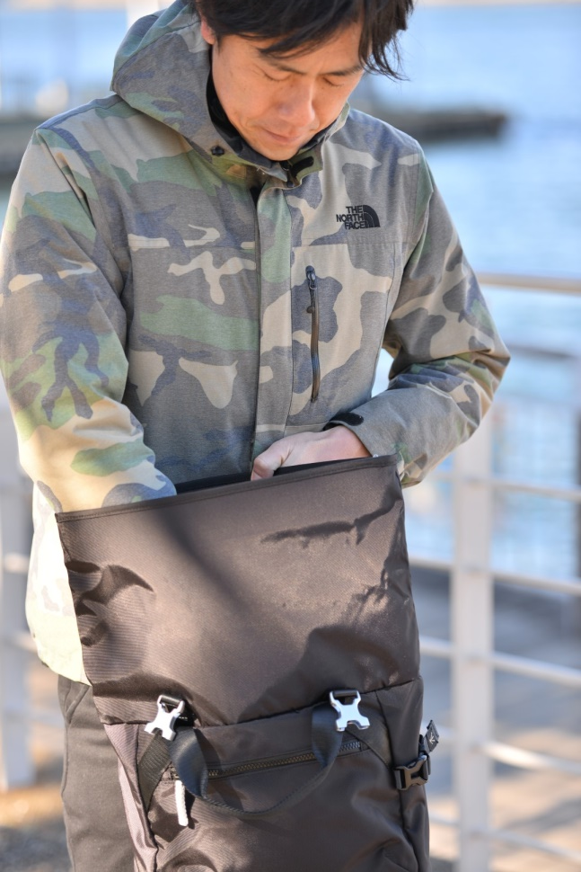
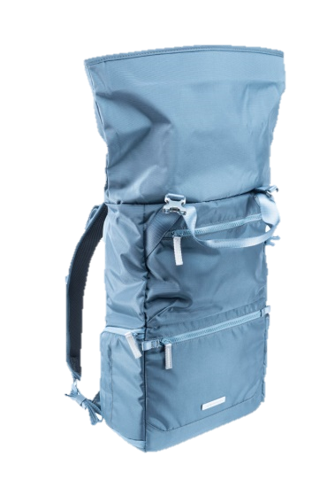
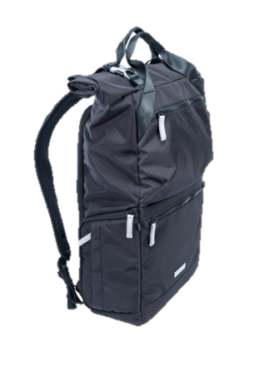
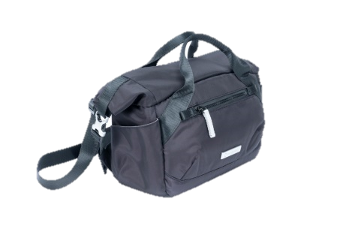
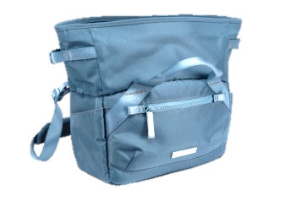
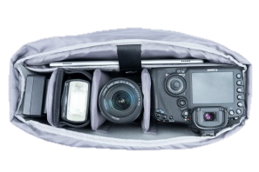
VEO FLEX USP #1
VEO FLEX SALES PRESNTATION
EXTRA Space & EXTRA Wide
@ Great Capacity Flexibility & Gear Access
Backpacks offer up to double the personal space with rolltop extension, quick access side opening and secure full rear opening
Shoulder Bags sports a uniquely wide mouth zipper opening, extra spacious main compartment and super easy extraction of camera
High capacity low profile for all sizes!
Notes:
Note: Click on the “Picture Place Holder”, then send the picture back.

Slide 5
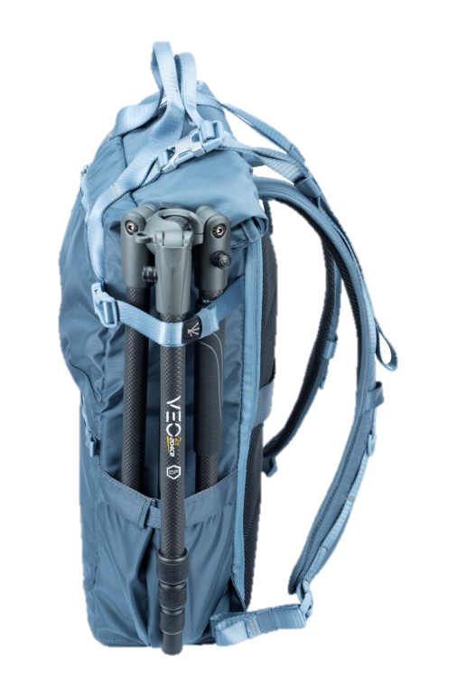
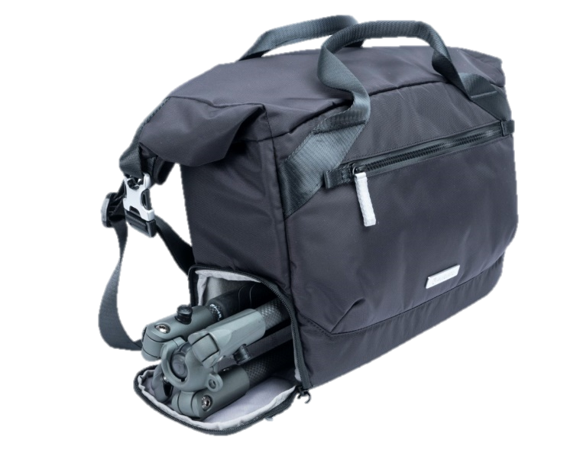

VEO FLEX USP #2
VEO FLEX SALES PRESNTATION
VEO 2 GO TRIPOD LINK
= UNIQUE TRIPOD + BAG PACK
VEO FLEX 35M Shoulder Bag with unique super compact Tripod Inside model!
VEO FLEX Backpacks are great value models with external Tripod Connection
VEO FLEX Small Shoulder Bags are fantastic “Bonus” offer
Notes:
Note: Click on the “Picture Place Holder”, then send the picture back.

Slide 6
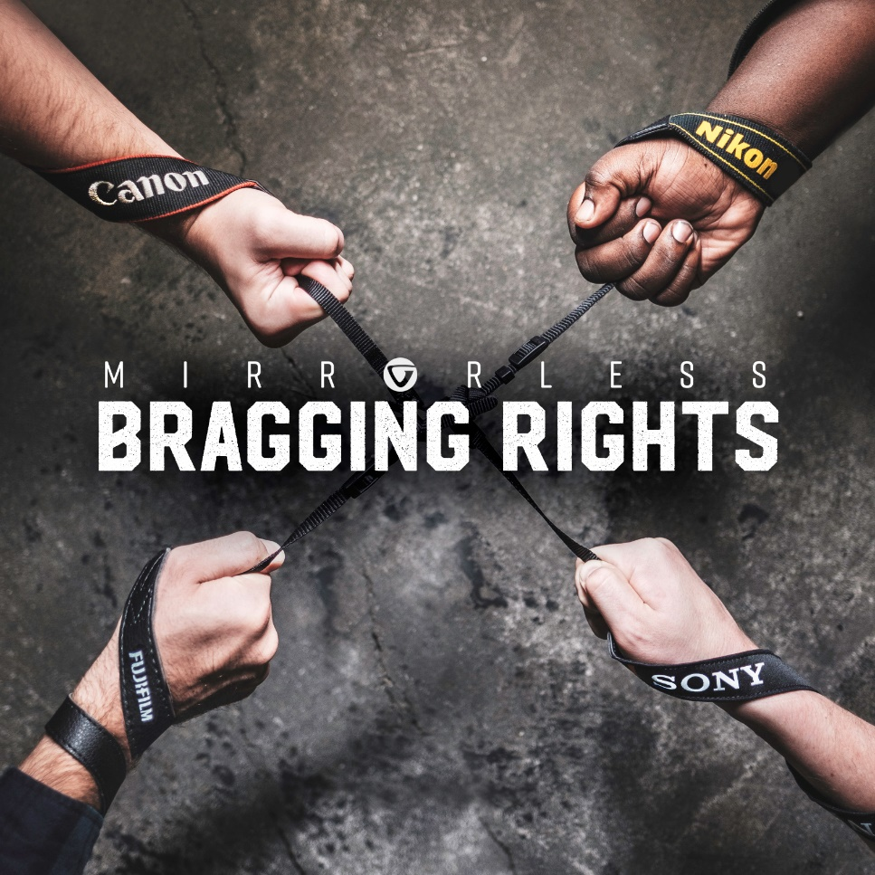
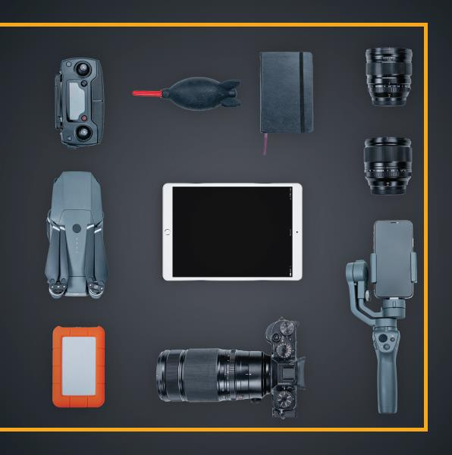
VEO FLEX USP #3
VEO FLEX SALES PRESNTATION
COMPACT M
= BEST FIT for MIRORRLESS/CSC/HYBRID
Size = Perfect fit for Mirorrless/CSC/Hybrid Camera Models
Also great for entry level DSLR thanks to rolltop flexibility
Perfect fit for camera gear PLUS room for personal essentials
Protective Bag MINUS bulk = easy to carry everywhere & anywhere
M for Mirorrless & Much More…
Notes:
Note: Click on the “Picture Place Holder”, then send the picture back.

Slide 7
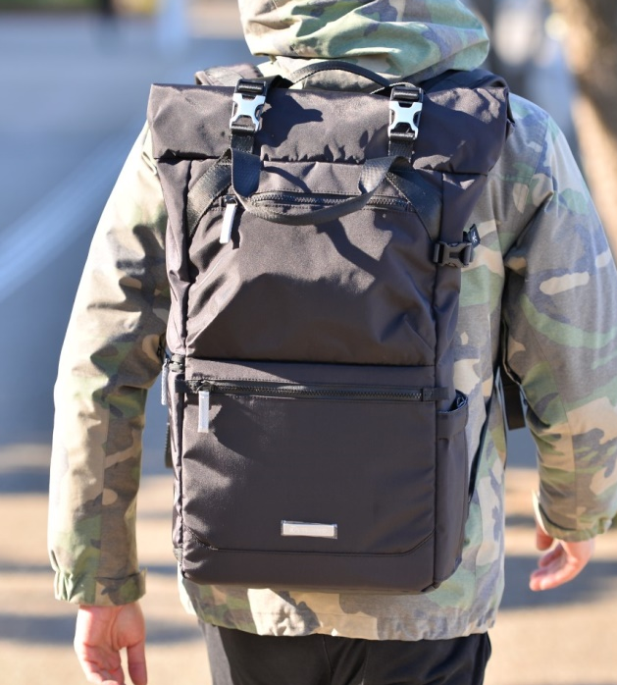

VEO FLEX SELLING PROPOSITION
VEO FLEX SALES PRESNTATION
Unique EXTRA SPACE & EXTRA WIDE Opening
Roll top in backpacks DOUBLES personal storage
Roll top in shoulder bags offers unique access
M = Perfect fit for Mirorrless/CSC/Hybrid Cameras
Perfect for Full Frame as well as entry DSLR
Backpacks with quick side access & secure rear access
Focus Model VEO GO 35M with VEO 2 GO tripod INSIDE
Notes:
Note: Click on the “Picture Place Holder”, then send the picture back.

Slide 8
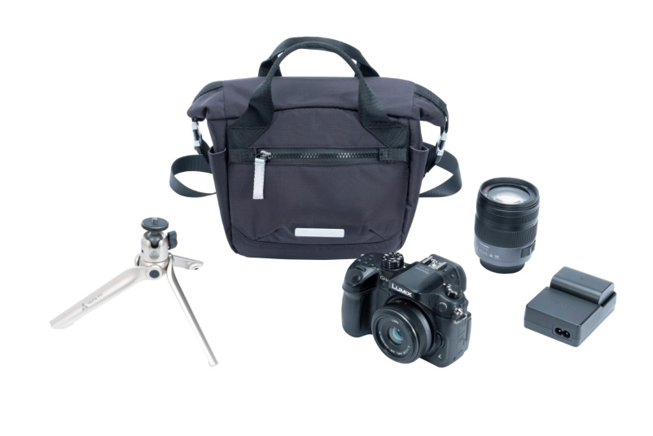
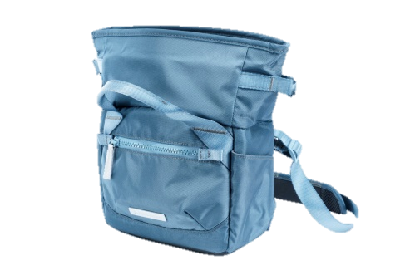




VEO FLEX 18M HIGHLIGHTS
VEO FLEX SALES PRESNTATION
The VEO FLEX 18M is a slim rolltop shoulder bag for a Mirrorless/CSC/Hybrid Camera with a kit lens attached plus extra lens or flash and essential accessories.
Flexible Capacity – compact with extra rolltop space
Easy Access – extra wide opening
Always protected - well-padded all round
Secure - full zip plus “roll and buckle up” closing
No fumbling - light colored interior makes finding things easy
Well organized - dedicated pockets for all essentials
Classically Stylish - functionality infused with design
Keep dry - total coverage rain cover
Internal Dimensions
Camera Compartment: 180 × 100 × 165 mm / 7 1/8” × 3 7/8” × 6 1/2”
Exterior dimension: 280 × 125 × 200 mm / 11” × 4 7/8” × 7 7/8”
Weight: 440g / 0.97lbs
Max loading: 1.6kg / 3.53lbs
or
Available in two distinct colors: Black & Blue
Notes:
Note: Click on the “Picture Place Holder”, then send the picture back.

Slide 9
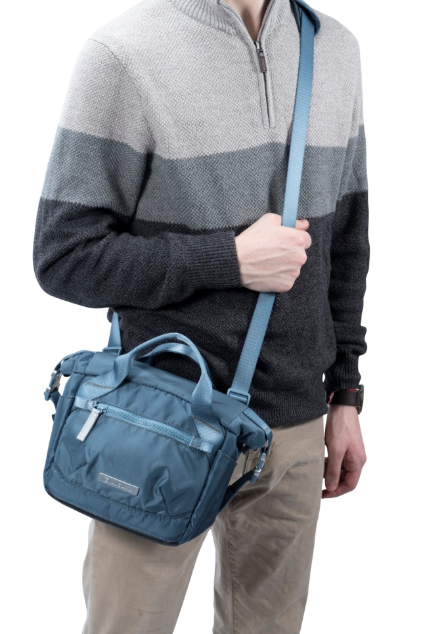
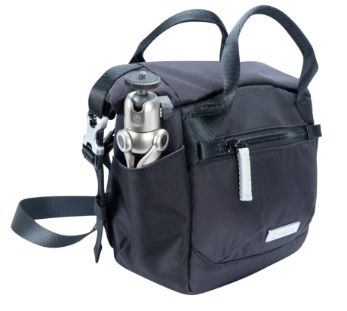
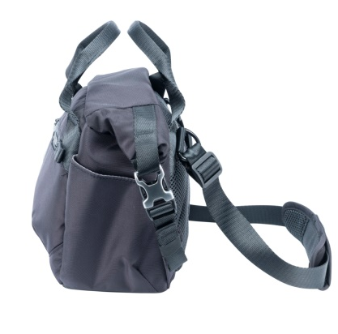
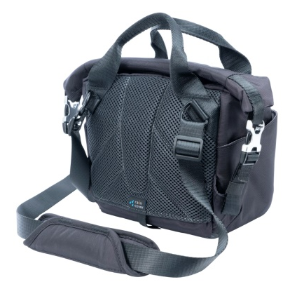
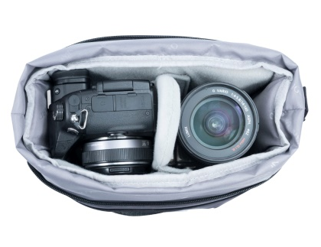
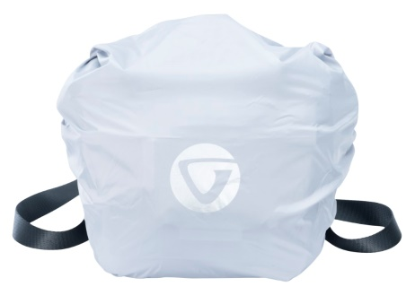
VEO FLEX 18M HIGHLIGHTS
VEO FLEX SALES PRESNTATION
Notes:
Note: Click on the “Picture Place Holder”, then send the picture back.

Slide 10
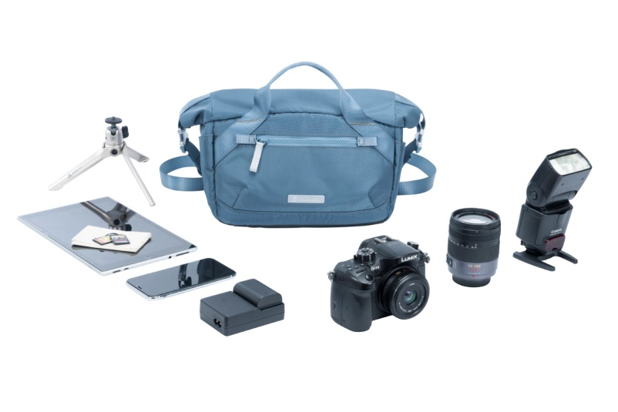
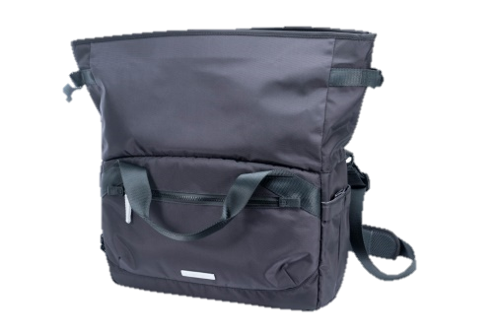

VEO FLEX 25M HIGHLIGHTS
VEO FLEX SALES PRESNTATION
The VEO FLEX 25M is a slim rolltop shoulder bag for a Mirrorless/CSC/Hybrid Camera with a kit lens attached plus 2-3 extra lenses, flash and essential accessories. Alternatively, it can also fit a small drone or small gimbal.
Flexible Capacity – compact with extra rolltop space
Easy Access – extra wide opening
Always protected - well-padded all round
Secure - full zip plus “roll and buckle up” closing
No fumbling - light colored interior makes finding things easy
Well organized - dedicated pockets for all essentials
Classically Stylish - functionality infused with design
Keep dry - total coverage rain cover
Internal Dimensions
Camera Compartment: 250 × 110 × 165 mm / 9 7/8” × 4 3/8” × 6 1/2”
Exterior dimension: 330 × 150 × 200 mm / 13” × 5 7/8” × 7 7/8”
Weight: 580g / 1.28lbs
Max loading: 3.2kg / 7.05lbs
or
Available in two distinct colors: Black & Blue
Notes:
Note: Click on the “Picture Place Holder”, then send the picture back.

Slide 11
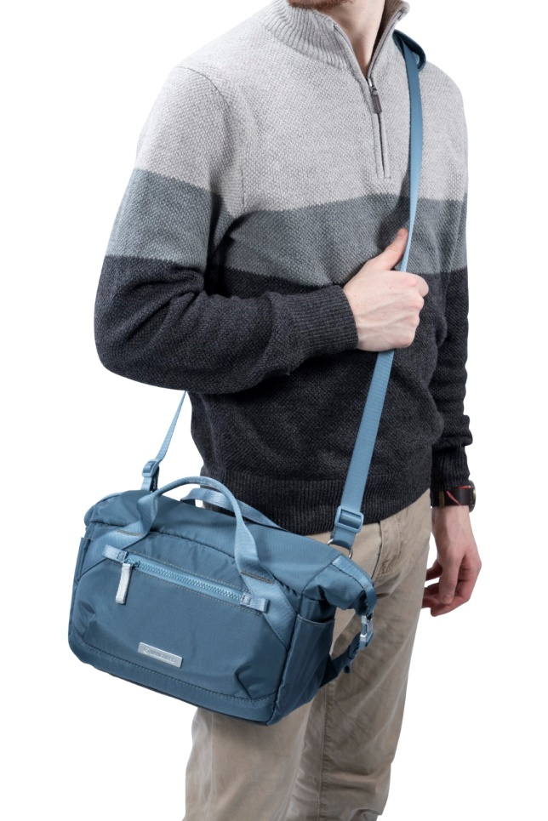
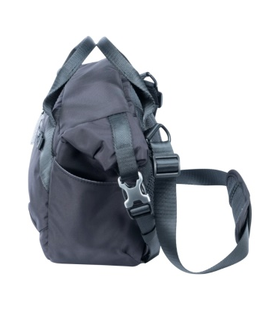
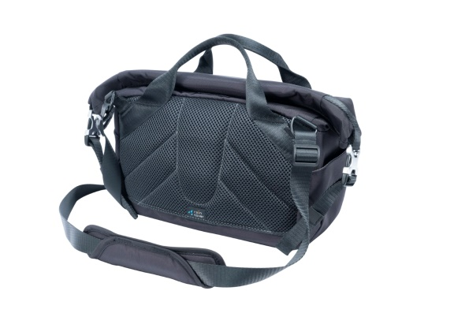
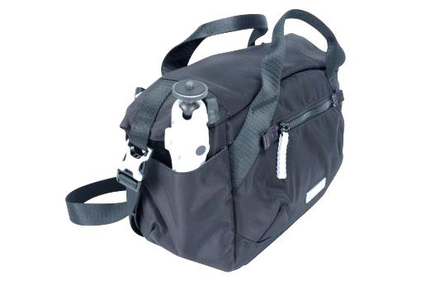
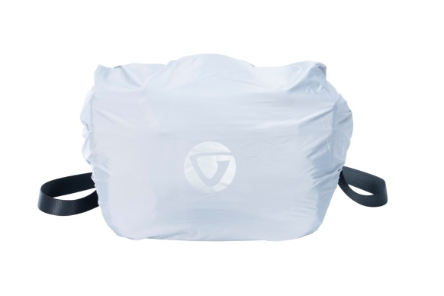
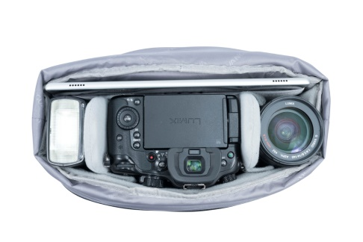
VEO FLEX 25M HIGHLIGHTS
VEO FLEX SALES PRESNTATION
Notes:
Note: Click on the “Picture Place Holder”, then send the picture back.

Slide 12
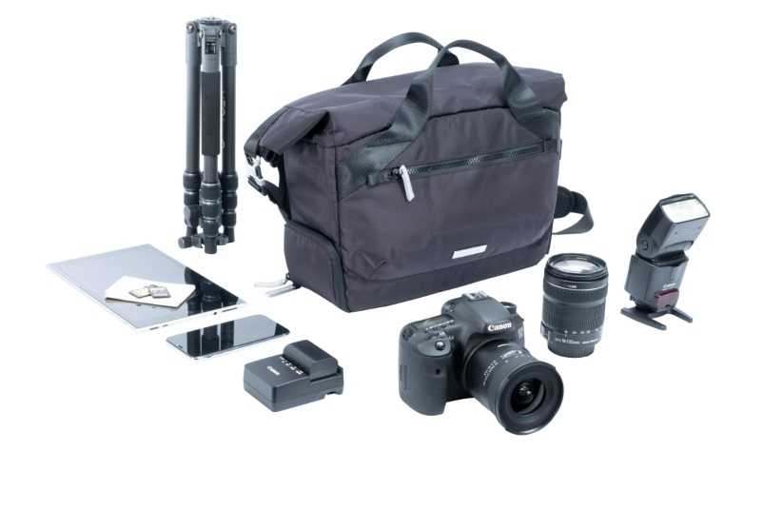
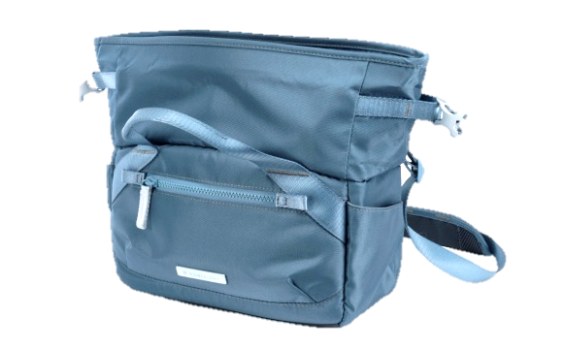





VEO FLEX 35M HIGHLIGHTS
VEO FLEX SALES PRESNTATION
The VEO FLEX 35M is a slim rolltop shoulder bag for a Mirrorless/CSC/Hybrid Camera with lens attached, additional 2-3 lenses, or 2 lenses plus flash, accessories, 13” laptop, and the standard VEO 2 GO tripod inside (H=High models will not fit). Alternatively, it can also fit a small drone or small gimbal.
Flexible Capacity – compact with extra rolltop space
Easy Access - extra wide opening
Always protected - well-padded all round
Secure - full zip plus “roll and buckle up” closing
No fumbling - light colored interior makes finding things easy
Business oriented - holds a 13” laptop
Well organized - dedicated pockets for all essentials
Classically Stylish - functionality infused with design
Keep dry - total coverage rain cover
Internal Dimensions
Camera Compartment: 330 × 120 × 240 mm / 13” × 4 3/4” × 9 1/2”
Exterior dimension: 410 × 170 × 265 mm / 16 1/8” × 6 3/4” × 10 3/8”
Weight: 980g / 2.16lbs
Max loading: 5.5kg / 12.12lbs
or
Available in two distinct colors: Black & Blue
Notes:
Note: Click on the “Picture Place Holder”, then send the picture back.

Slide 13
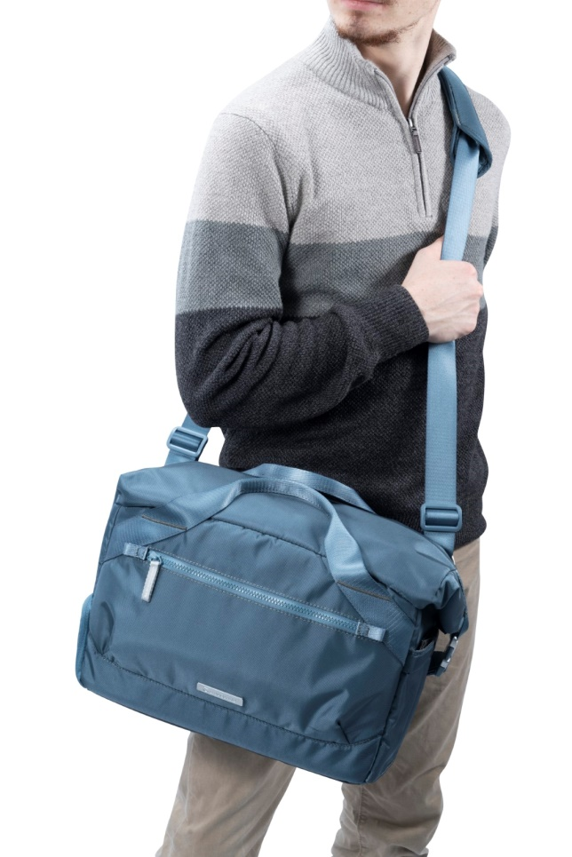
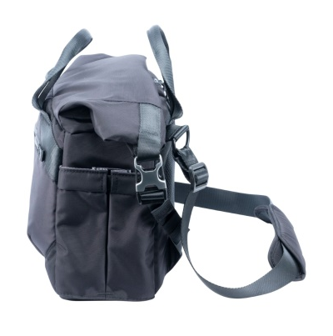
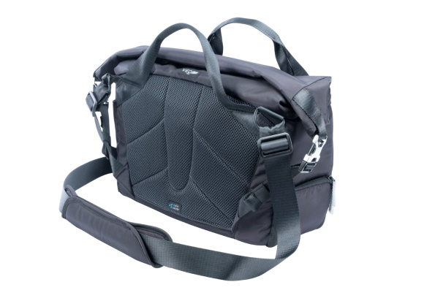
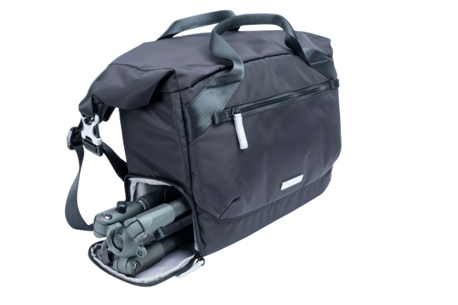
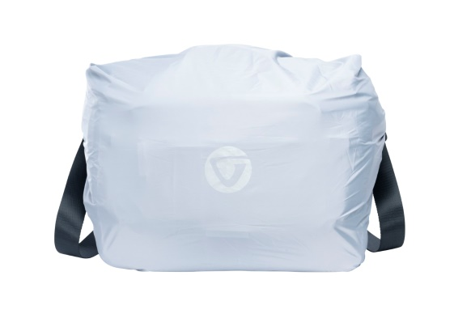
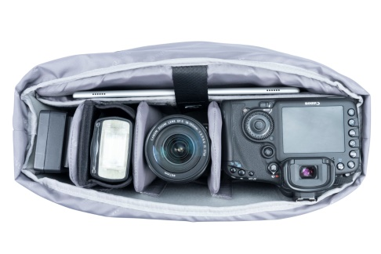
VEO FLEX 35M HIGHLIGHTS
VEO FLEX SALES PRESNTATION
Notes:
Note: Click on the “Picture Place Holder”, then send the picture back.

Slide 14
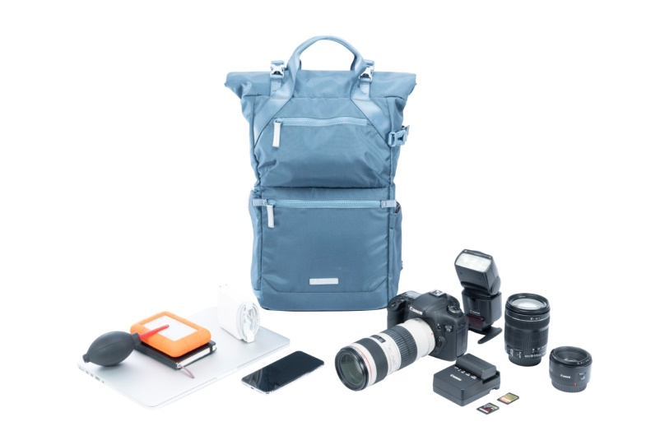
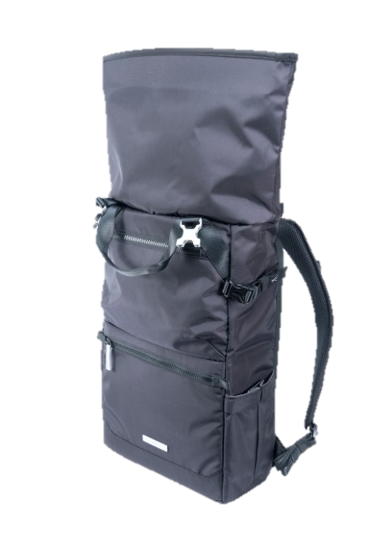
VEO FLEX 43M HIGHLIGHTS
VEO FLEX SALES PRESNTATION
The VEO FLEX 43M is a slim rolltop backpack for a Mirrorless/CSC/Hybrid Camera with lens attached, additional 2-3 lenses, flash, accessories, 9.7” tablet, and a VEO 2 GO tripod. Alternatively, it can also fit small drone or small gimbal.
Flexible Capacity – compact with extra rolltop space
Easy Access - extra wide opening
Always protected - well-padded all round
Secure - full zip plus “roll and buckle up” closing
No fumbling - light colored interior makes finding things easy
Business oriented - holds a 9.7” tablet
Well organized - dedicated pockets for all essentials
Off the clock - transforms into an everyday Daypack
Classically Stylish - functionality infused with design
Keep dry - total coverage rain cover
Internal Dimensions
Camera Compartment: 245 × 110 × 430 mm / 9 5/8” × 4 3/8” × 16 7/8”
Exterior dimension: 360 × 170 × 450 mm / 14 1/8” × 6 3/4” × 17 3/4”
Weight: 1.02kg / 2.25lbs
Max loading: 4.2kg / 9.26lbs
or
Available in two distinct colors: Black & Blue
Notes:
Note: Click on the “Picture Place Holder”, then send the picture back.

Slide 15
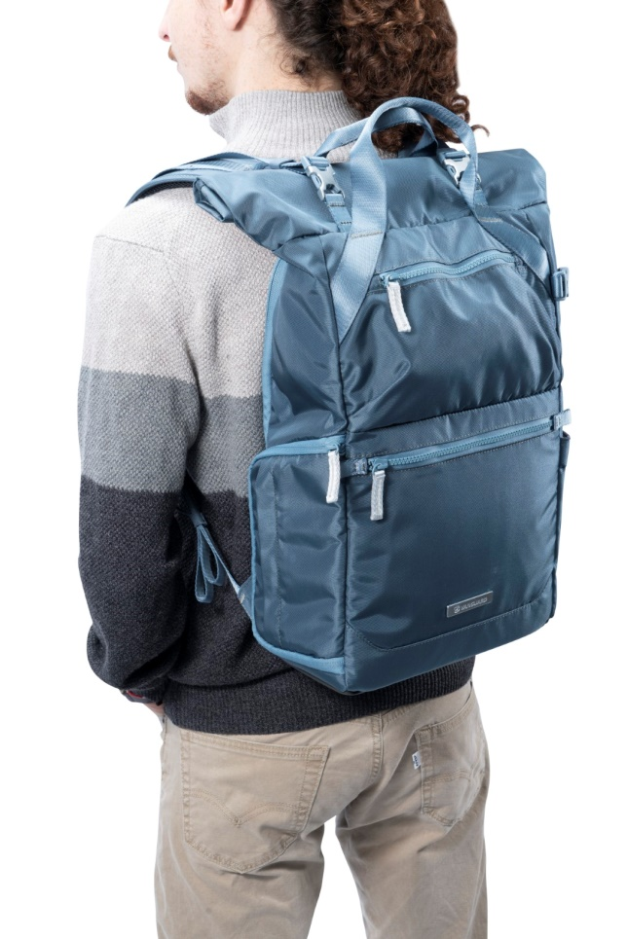
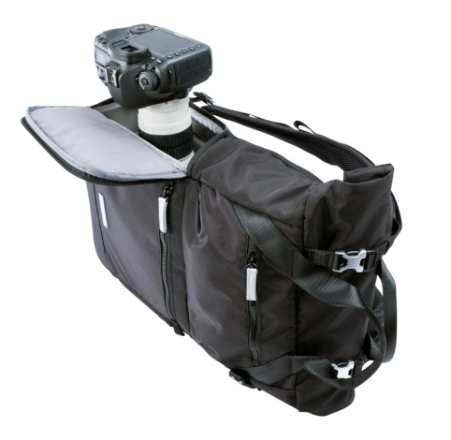
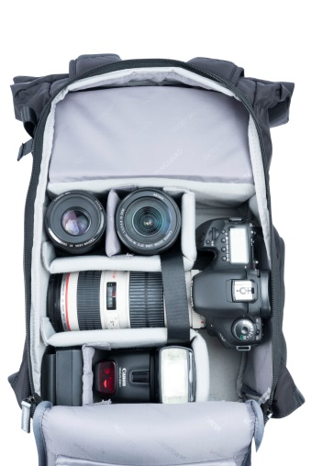
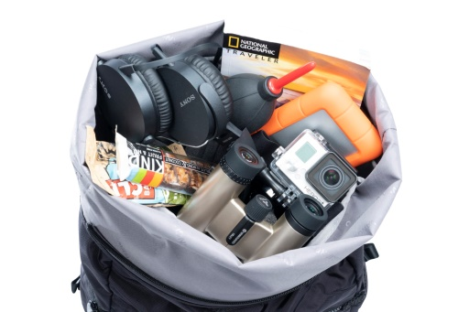
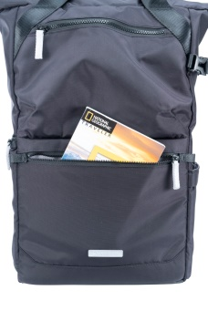
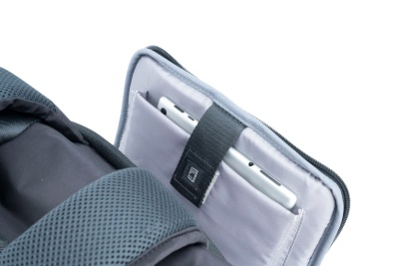
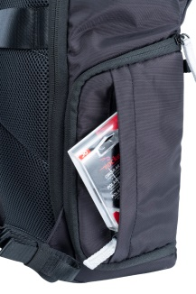
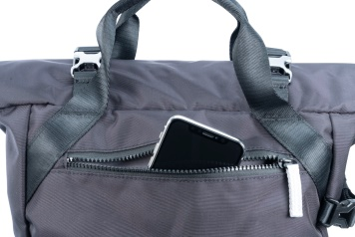
VEO FLEX 43M HIGHLIGHTS
VEO FLEX SALES PRESNTATION
Notes:
Note: Click on the “Picture Place Holder”, then send the picture back.

Slide 16
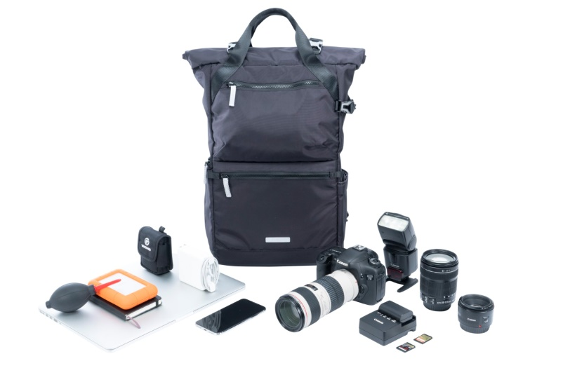
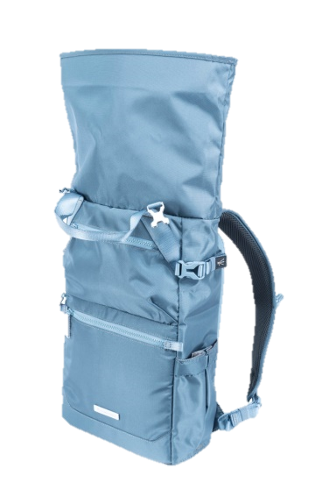

VEO FLEX 47M HIGHLIGHTS
VEO FLEX SALES PRESNTATION
The VEO FLEX 47M is a slim rolltop backpack fits 2 Mirrorless/CSC/Hybrid Cameras with lens attached, additional 2-3 lenses, flash, accessories, 15” slim laptop, and a VEO 2 GO tripod. Alternatively, it can also fit a small drone or small gimbal.
Flexible Capacity – compact with extra rolltop space
Always supported – VEO 2 GO tripod connection
Quick Access – side opening
Always protected - well-padded all round
Secure - full zip plus “roll and buckle up” closing
No fumbling - light colored interior makes finding things easy
Business oriented - holds a 15” Slim Laptop
Well organized - dedicated pockets for all essentials
Off the clock - transforms into an everyday Daypack
Classically Stylish - functionality infused with design
Keep dry - total coverage rain cover
Internal Dimensions
Camera Compartment: 275 × 120 × 470 mm / 10 1/8” × 4 3/8” × 18 1/2”
Exterior dimension: 380 × 180 × 485 mm / 15” × 7 1/8” × 19 1/16”
Weight: 1.16kg / 2.56lbs
Max loading: 7.5kg / 16.53lbs
or
Available in two distinct colors: Black & Blue
Notes:
Note: Click on the “Picture Place Holder”, then send the picture back.

Slide 17
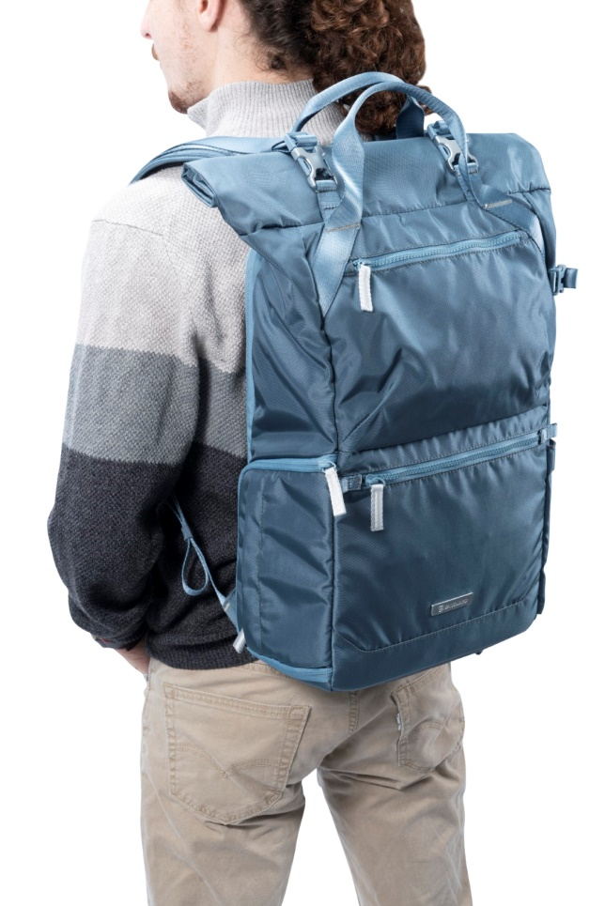



VEO FLEX 47M HIGHLIGHTS
VEO FLEX SALES PRESNTATION
Notes:
Note: Click on the “Picture Place Holder”, then send the picture back.

Slide 18


